Slide 1




LOOKING OUT FOR
EACH OTHER
LOOKING OUT FOR
It Does Matter is a registered charity in England and Wales (CIO) no. 1216940.
© 2024 PSHE Association

Slide 2
OUR CLASS GROUND RULES
Insert ground rules here
Bullet 1
Bullet 2
Bullet 3
© 2024 PSHE Association

Slide 3
LEARNING OBJECTIVES
LEARNING OBJECTIVE:
To learn about strategies to support personal safety, especially when out socialising with peers.
LEARNING OBJECTIVES:
Identify situations where people may feel unsafe when out socialising
Evaluate how to support personal safety for each other
Analyse the effect of attitudes towards personal safety and violence against women and girls
© 2024 PSHE Association

Slide 4
SAFE OR UNSAFE SCENARIOS?
Order these scenarios from the most to least safe, explaining your choice for the least safe.
Is there anything the person could do to make the unsafe situations safer?
Walking home alone after a night out
Going to watch live music alone
Going to a bar with friends
Going on a first date to the cinema
Inviting new friends over for a games night at home
Staying late at the library after everyone else has gone
Approaching a stranger on the street who looks upset
© 2024 PSHE Association

Slide 5

WHAT MAKES IT UNSAFE?
What are the key factors that might make social situations unsafe?
Is this different depending on the person’s gender?
Walking home alone after a night out
Going to a bar with friends
Inviting new friends over for a games night at home
Going to watch live music alone
Going on a first date to the cinema
Staying late at the library after everyone else has gone
Approaching a stranger on the street who looks upset
© 2024 PSHE Association

Slide 6

WHAT COULD THEY DO?
Option 1
Option 2
Your scenario
Option 3
Option 4
Around your scenario, add the possible options of what your character could do.
© 2024 PSHE Association

Slide 7
DID YOU THINK OF…
All go home and carry on drinking there
One friend could take Jane home
Scenario 1:
Jane and friends
Try to convince the bouncer to let her in
All go and try to get in another bar
Send Jane home in a taxi and carry on the night out
© 2024 PSHE Association

Slide 8
DID YOU THINK OF…
Leave her alone and get home
Tunde could stay behind and keep asking if she needs help
Scenario 2:
Tunde
Invite her to come with him and his friends
Offer to order her a taxi home
Offer to lend her his phone
© 2024 PSHE Association

Slide 9
DID YOU THINK OF…
Move seats and tell the bus driver
Get off the bus and find another way home
Scenario 3:
Isla and her friends
Report the crime to the police when they get home
Confront the man and shout at him
Try to ignore him
© 2024 PSHE Association

Slide 10
DID YOU THINK OF…
Try to persuade Leo not to go after Sofia
Do nothing and try to enjoy the rest of his night
Insist on going with Leo to find Sofia
Scenario 4:
Ivan
Tell all their friends what he is worried about
Speak to the other girls and see if they will go after Sofia
Call Leo out and tell him he thinks its creepy
© 2024 PSHE Association

Slide 11
CONSEQUENCES
Consequence
Consequence
Consequence
Consequence
Option 1
Option 2
Your scenario
Option 3
Option 4
Consequence
Consequence
Consequence
Consequence
What are the possible consequences of each option?
Overall, which do you think is the safest choice for the character?
© 2024 PSHE Association

Slide 12
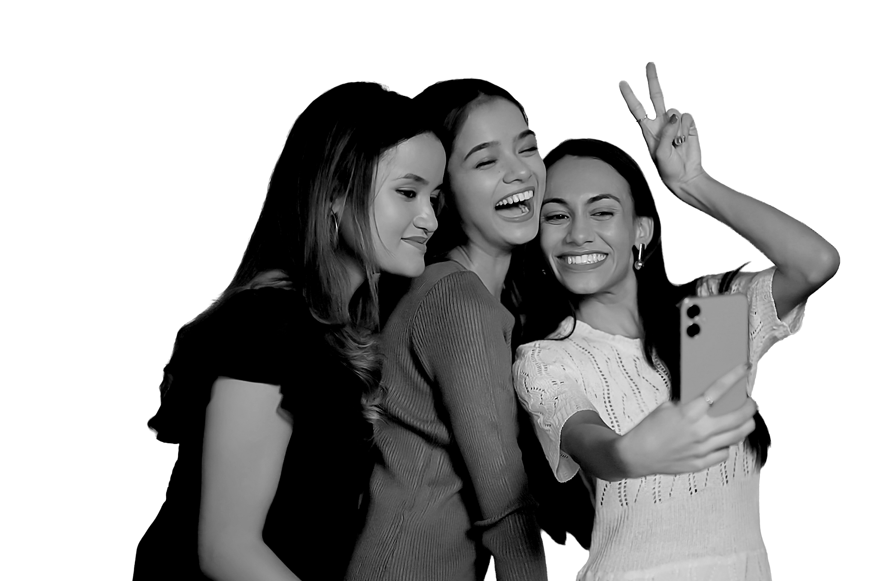
WHAT PREVENTS US?
Which option do you think is the most likely for the character to take?
Is it the same or different to the safest option?
What might prevent the characters from acting in the safest way? Think about:
Their thoughts and feelings
Societal norms or stereotypes
© 2024 PSHE Association

Slide 13
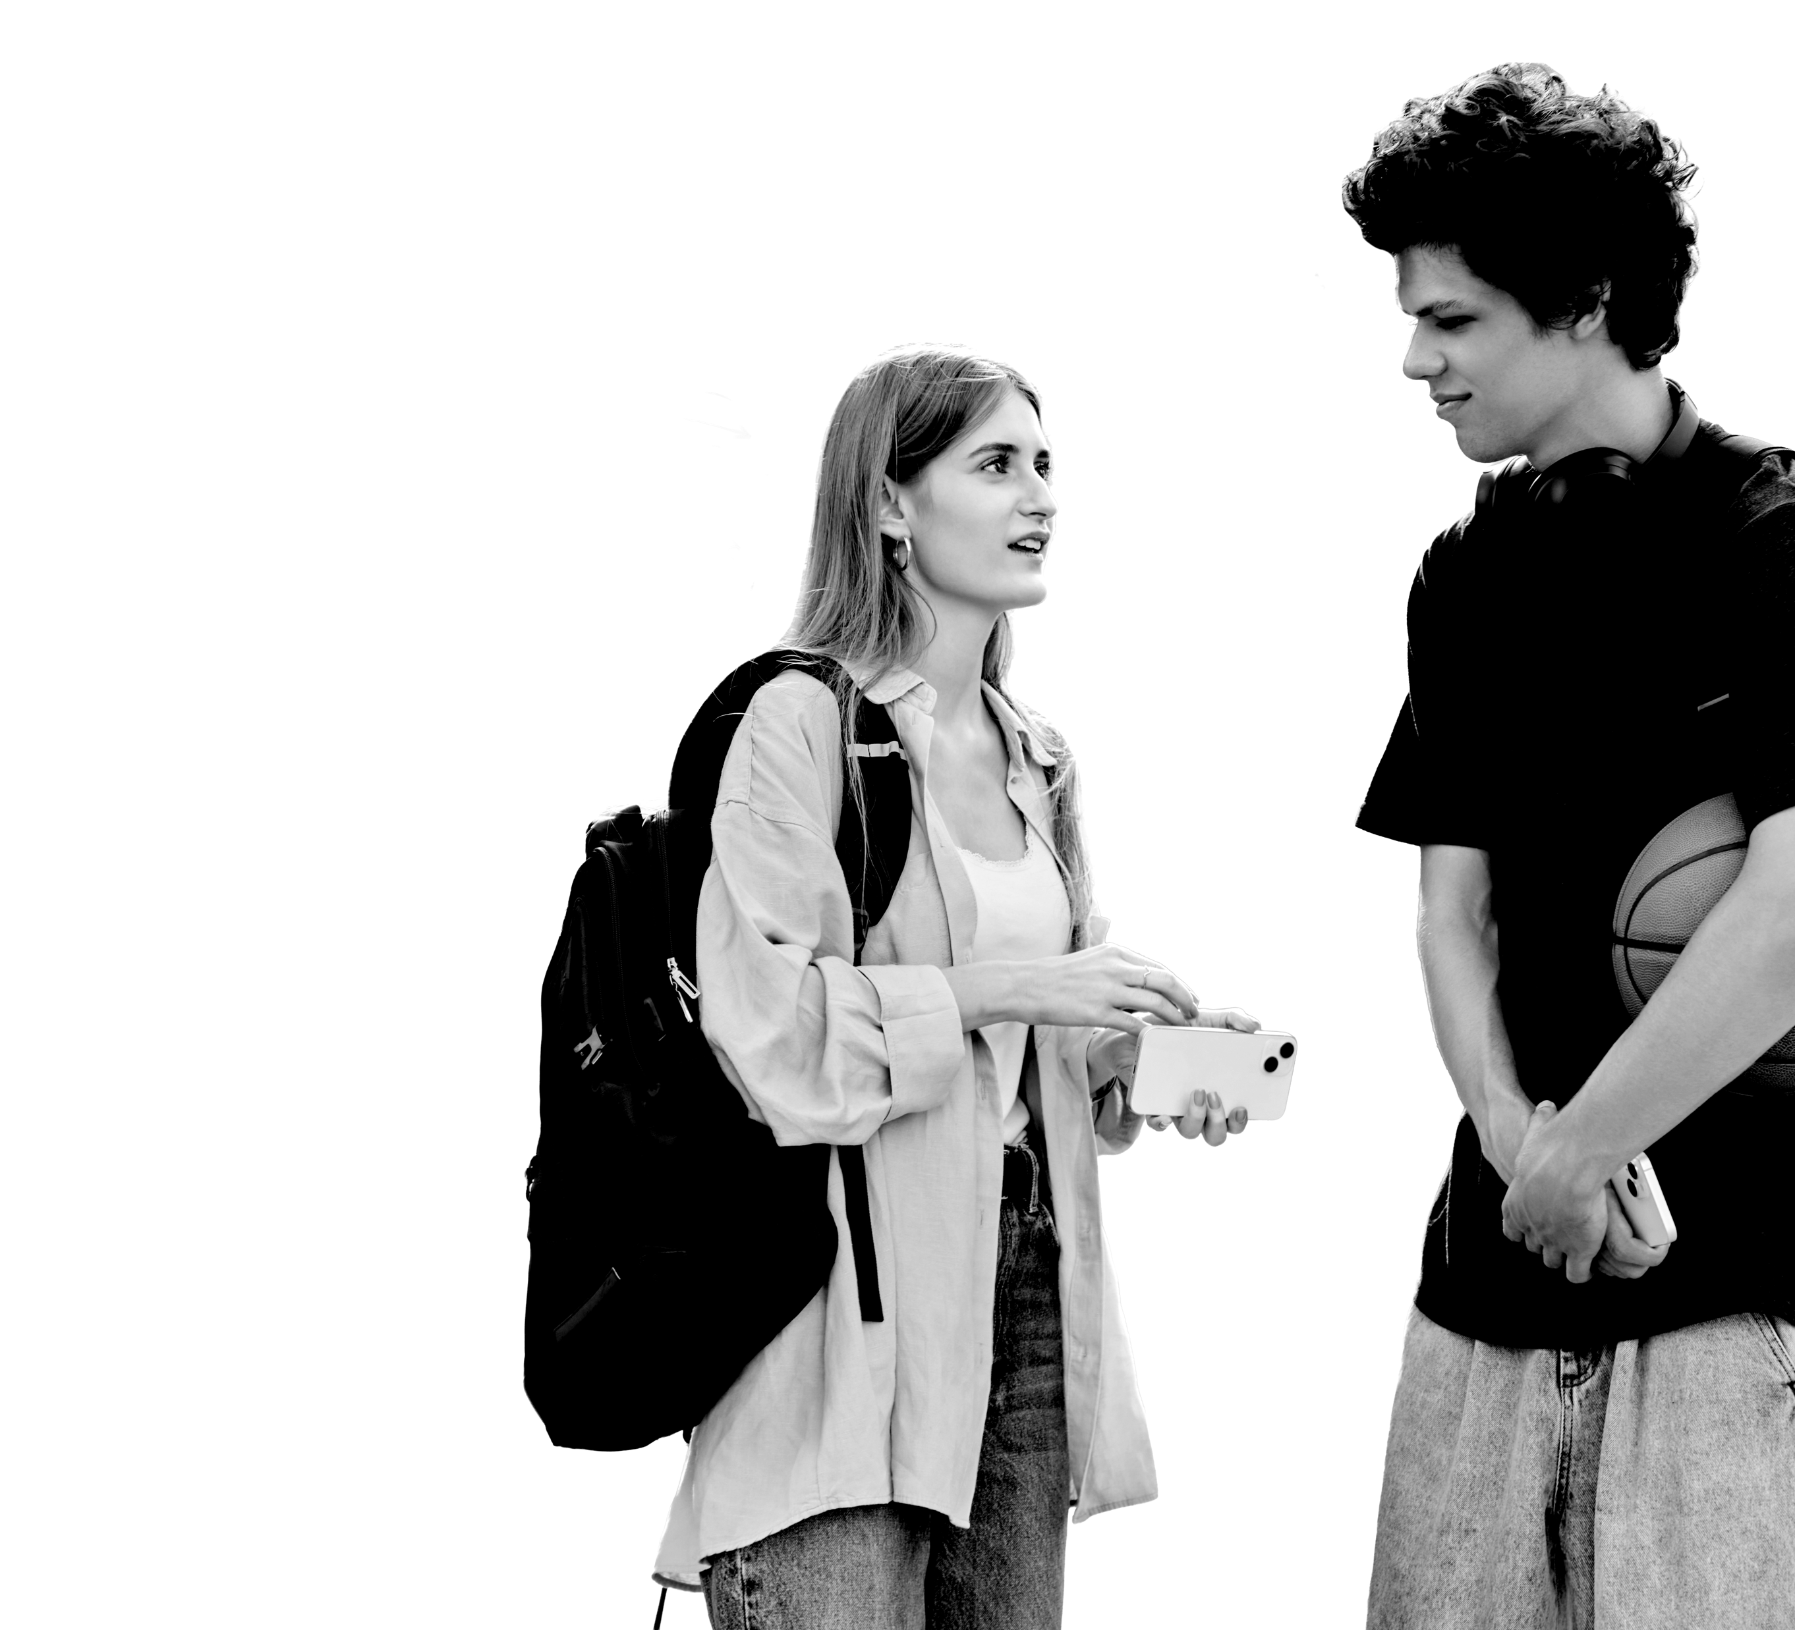
WHAT PREVENTS US?
Choose one of the factors that might prevent someone from making the safest choice.
As a group, write a response to this thought, feeling or view that might help the person behave differently next time.
Did you know?
It is important to report any non-contact sexual offence, witnessed or experienced. This can make a real difference in helping the police build a picture of possible predators and to prevent them from committing more serious crimes.
© 2024 PSHE Association

Slide 14

WHAT DO YOU THINK NOW?
Revisit the learning outcomes and rate where you think your confidence was at the start of the lesson, compared to now.
Provide an explanation for the biggest change in confidence you have experienced.
Complete the personal reflection.
© 2024 PSHE Association

Slide 15
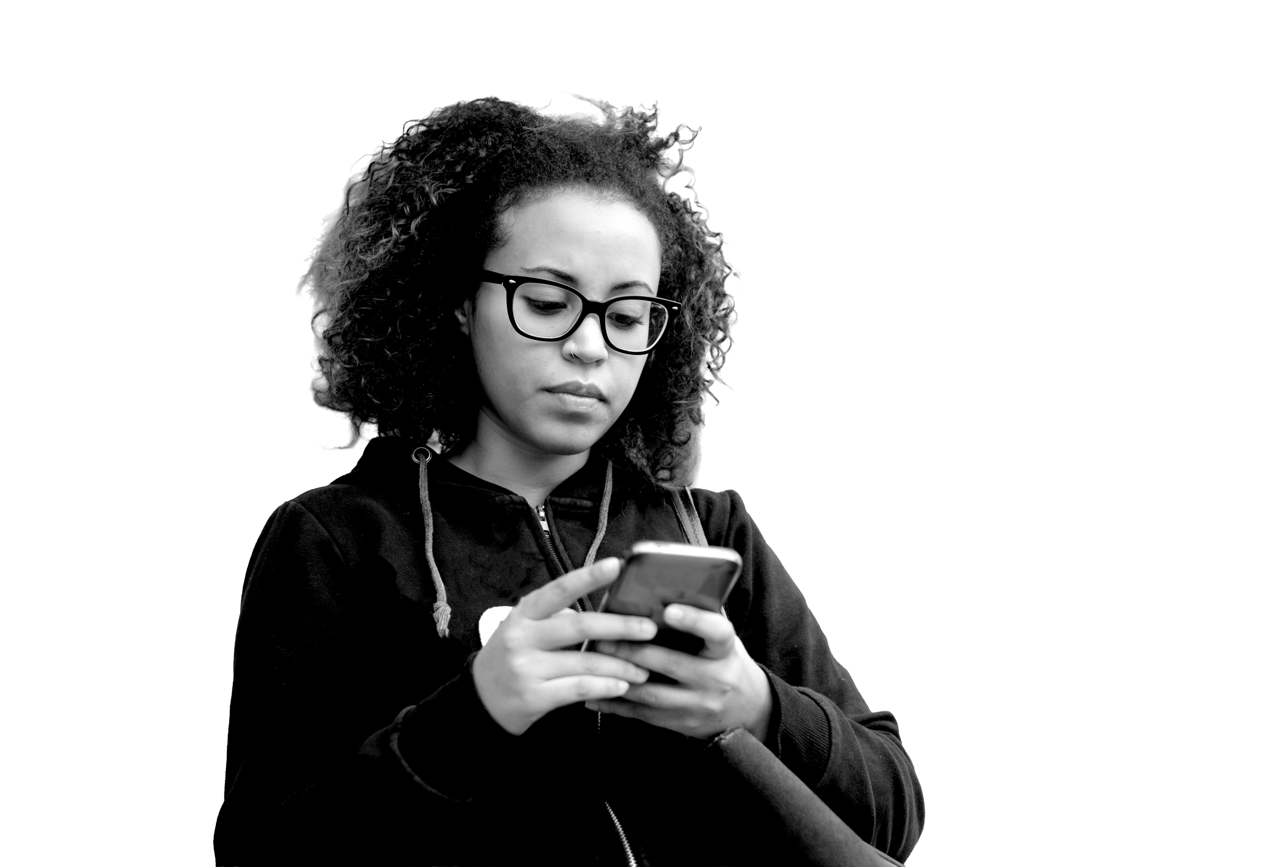
Sources of support
In school you can speak to: your tutor, head of year or the safeguarding lead.
Contacting Childline www.childline.org.uk
Contacting Victim Support www.victimsupport.org.uk
Reporting a non-urgent crime using 101 or online at www.police.uk
In an emergency, calling 999
Reporting crime anonymously using www.fearless.org.uk
© 2024 PSHE Association

Slide 16

EXTENSION IDEA
Create an in-school campaign based on the learning from this lesson.
Your campaign should include:
Strategies to maintain personal safety
when socializing
How to challenge unhelpful attitudes
Sources of support
© 2024 PSHE Association

